Slide 1

Partnering with Community Colleges to Grow and Strengthen the Community Responder Workforce
Dec. 12, 2024 |
Anne Larsen, Melissa McKee, Dr. Amy Watson, Audrey Thompson, Jeron Dorsey, Rachel Stams, and Dr. Jesse Ivory

Slide 2
Objectives
Learn what the general community responder program field believes are the critical education, skills, and credentials needed in this profession.
Learn how Evanston, Illinois, established its C.A.R.E. team through a critical partnership with Oakton College.
Learn tips on how other programs and colleges can partner to increase and strengthen the community responder program workforce.

Slide 3
Agenda
Welcome
Introductions
Keynote Presentation by Dr. Amy Watson
Evanston, Illinois, Panel Discussion
Questions from the Audience
Closing

Slide 4
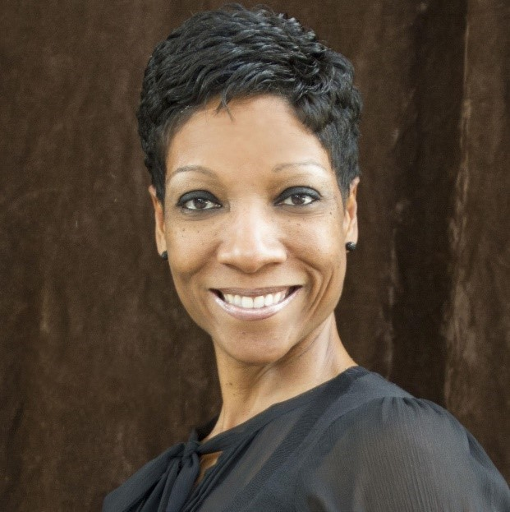
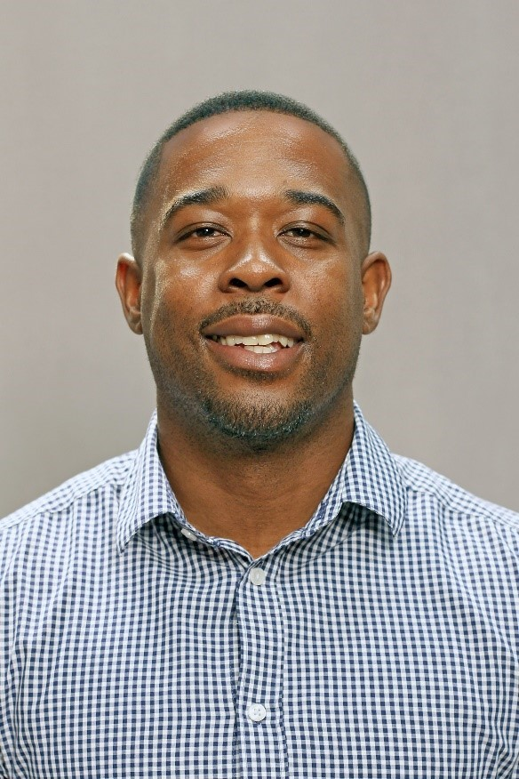
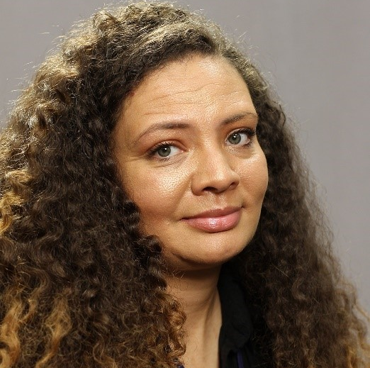

Panelists
Audrey Thompson, Director, Parks and Recreation Department
Jeron Dorsey, Deputy Director, Parks, Recreation and Community Services
Rachel Stams, Evanston C.A.R.E. Team Member
Dr. Jesse Ivory, Assistant Vice President, Oakton College

Slide 5

Keynote Speaker
Dr. Amy Watson, Wayne State University, School of Social Work

Slide 6
A National Study of Community Responder Workforce Needs
Dr. Amy Watson

Slide 7
Acknowledgments
Co-PIs Michael Compton and Leah Pope-Columbia University
Our study team also includes Tahir Duckett, Lucia Mock, Kellan McNally, Lucinda Qu, Lisa Elliot, and Ashnee Patel.
The project is guided by an advisory board composed of people representing lived experience, families, peer services, youth services, community responder programs, mental health providers, and law enforcement:
  Chyrell Bellamy, Ron Bruno, Whitney Bunts, Taleed El-Sabawi, Dan Fichter, Don Kamin, Stefanie Kaufman-Mthimkhulu, Angela Kimball, Moki Macias, Ama Merrell, Matthew Moody, Eric Rafla-Yaun, Patricia Strode, Eduardo Vega
This work was made possible with funding from NAMI National.

Slide 8
Background: The Need to Develop the Community Response Workforce
Recognition of the need to reduce the role of law enforcement in behavioral health crisis response
Behavioral health workforce shortages
  47 percent of the U.S. population lives in BH workforce shortage areas
  Existing workforce lacks adequate diversity
  Mismatch in training and interest among existing BH professionals and community response needs
So, how do we build the community response workforce?

Slide 9
Goals
Identify the core competencies needed for safe and effective behavioral health crisis response to inform the development of a diverse workforce that is prepared to respond independent of law enforcement most of the time.
Identify implementation and policy barriers, facilitators, and issues.
Identify steps required to develop a recognized professional certification process to facilitate rapid entry and workforce expansion.
Develop and implement a training and credentialling process for a new professional role: Community Behavioral Health Crisis Responder

Slide 10
Project Design
Advisory Board
Literature Review
Key Informant Interviews
  Part 1: People working within the crisis/community response ecosystem
  Part 2: People with knowledge relevant to implementing a new profession/ credentialling process
Focus Groups
People working as community/mobile crisis team responders
People with lived experience of mental illness/use of crisis services
Family members
Review of other professional training programs

Slide 11
What We Learned
Need for core values specific to this work.
Important characteristics of people doing this work include compassion/empathy, ability to self regulate/stay calm, lived experience broadly defined, flexible problem-solver.
Most important skills are related to connecting, building trust, and helping the person feel safe.
  People do not like feeling like agency agenda/paperwork is driving the service.
Responders can be trained in skills for maintaining safety in the community and supported with agency protocols, technology, etc.
Notes:
Values—we used out data and worked with advisory group to develop
Characteristics—comfortable in uncomfortable situations, compassionate curiosity, ability to remain calm-self regulate, problem solving, --Lived experience-broadly defined
Skills--

Slide 12
Core Values of Community Behavioral Health
Crisis Responders (CBHCRs)
DIGNITY
RELATIONSHIP
COLLABORATION
AUTONOMY:
SUPPORT SYSTEM
INTEGRITY
ADVOCACY:
TRAUMA-INFORMED
VALUE OF LIVED EXPERIENCE

Slide 13
Core Competencies & Skills
RELATIONSHIP BUILDING-RELATED COMPETENCIES AND SKILLS
Self Awareness
Interpersonal skills
Unconditional Positive Regard
COMMUNICATION-RELATED COMPETENCIES AND SKILLS
Engagement
Active Listening
Language and Communication
Cross Cultural

Slide 14
Core Competencies & Skills
KNOWLEDGE-BASED COMPETENCIES AND SKILLS
Mental/Behavioral Health
Cultural Humility
Physical Health
Safety Assessment and Intervention
Interventions
Documentation and Privacy Practice

Slide 15
Core Competencies & Skills
SAFETY-RELATED COMPETENCIES AND SKILLS
Managing the physical environment
Preparation
Crisis de-escalation and maintaining safety
RESOURCE NAVIGATION AND ADVOCACY-RELATED COMPETENCIES AND SKILLS
SELF-CARE-RELATED COMPETENCIES AND SKILLS

Slide 16
What We Learned: Training Content
  Engagement skills
  Trauma-informed care
  Harm reduction
  Cultural humility
  Mental/behavioral health presentations
  Risk assessment
  Suicide intervention
  Motivational interviewing
  De-escalation
  Safety in the community
  Basic medical/First Aid/NARCAN
  Navigating community resources and geography
  Self-care/self-awareness/self- regulation
  Documentation/privacy practices
  Ethics
Training should be a mix of didactic, experiential, and field training.

Slide 17
What might such a training look like?
Prerequisites | Didactic Hours | Skills Practice/Lab | Practicum/ Internship | Credentialling
GED or High School Diploma | 120 hours | 30 hours minimum | 100 hours | Provisional Basic Certification after completing training program and passing practical exam. After 1000 hours supervised work experience, apply for full Basic Certification.
Could be completed in a six-week intensive block or in a more traditional course framework carrying academic credit.

Slide 18
Partnering with Community Colleges
Community colleges have experience developing and delivering professional training programs.
Community colleges have experience with workforce development and apprenticeship programs and know how to support students in these programs.
Community colleges are accessible.

